Slide 1
ER-5
13.5

Slide 2
Contents
Entity Relationship(ER) Examples

Slide 3
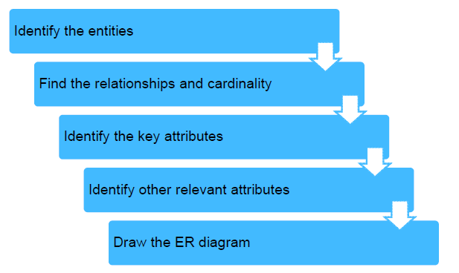
How to draw ER Model

Slide 4
Construct an ER diagram for hospital with a set of patient and medical doctors. Associate with each patient a log of various tests and examination conducted.

Slide 5
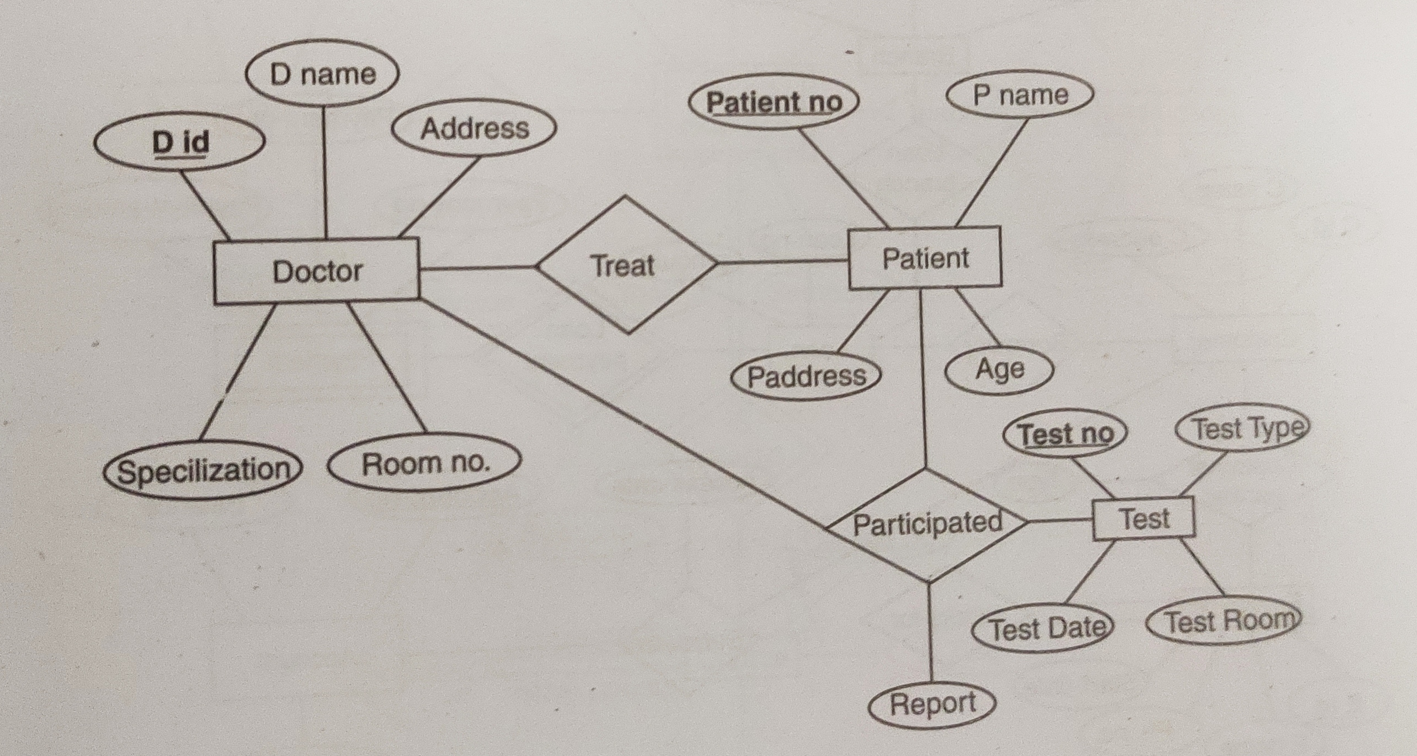
Construct an ER diagram for hospital with a set of patient and medical doctors. Associate with each patient a log of various tests and examination conducted.

Slide 6
Construct an E-R diagram for Banking System

Slide 7
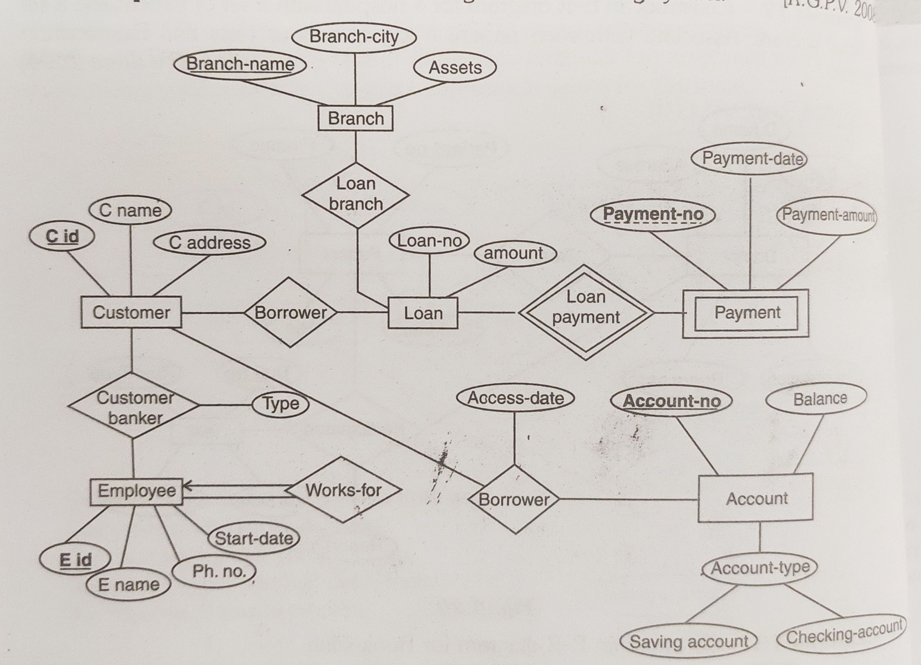
Construct an E-R diagram for Banking System

Slide 8
Construct an E-R diagram of a car insurance company that has a set of customers each of whom owns one or more cars. Each car has associated with it 0 to any number of recorded accidents. Construct appropriate tables for the same.

Slide 9
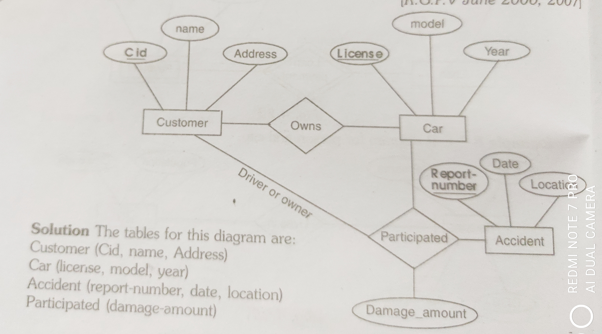
Construct an E-R diagram of a car insurance company that has a set of customers each of whom owns one or more cars. Each car has associated with it 0 to any number of recorded accidents. Construct appropriate tables for the same.

Slide 10
Consider a database used to record the marks that students get in different exams of different course offerings. Construct an E-R diagram that models exams as entities, and uses a ternary relationship, for the above database.

Slide 11
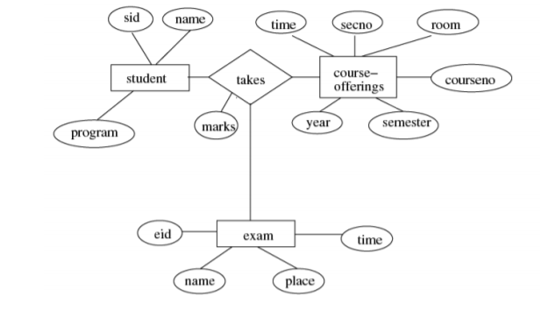
Consider a database used to record the marks that students get in different exams of different course offerings. Construct an E-R diagram that models exams as entities, and uses a ternary relationship, for the above database.

Slide 12
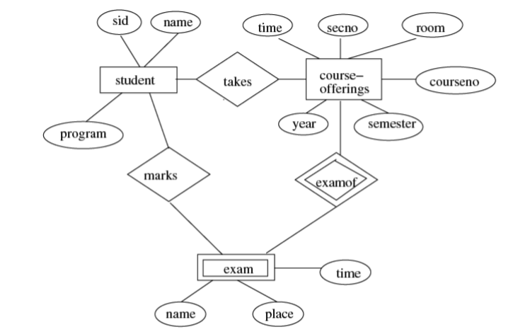
Construct an alternative E-R diagram that uses only a binary relationship between students and course-offerings. Make sure that only one relationship exists between a particular student and course-offering pair, yet you can represent the marks that a student gets in different exams of a course offering.

Slide 13
EasyShop Retail Application Case Study
1. One supplier can provide many quotations.
2. For every item, there will be a separate quotation.
3. Many suppliers can quote for the same item.
4. Many items can be outward to the several retail outlets.
5. One employee works for only one retail outlet.
6. One retail outlet can have many employees.
7. Many customers can purchase items from several retail outlets.
8. One employee can nominate many dependents

Slide 14
Steps can be considered for drawing ER Model

Slide 15
Steps in ER Modeling (1 of 5)
Step 1: Identify the entities
Supplier
Quotation
Item
RetailOutlet
Employee
Customer
Dependent

Slide 16
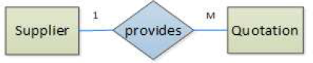
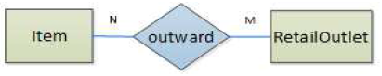
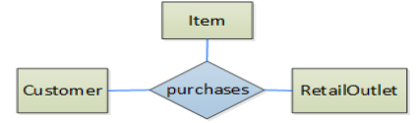
Steps in ER Modeling (2 of 5)

Slide 17
Steps in ER Modeling (3 of 5)
Step 3: Identify key attributes
Supplier supplierid
Quotation quotationid
Item itemcode
RetailOutlet retailoutletid
Employee empid
Customer customerid
Dependent

Slide 18
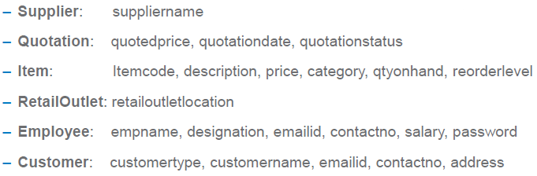
Steps in ER Modeling (4 of 5)
Step 4: Identify other relevant attributes

Slide 19
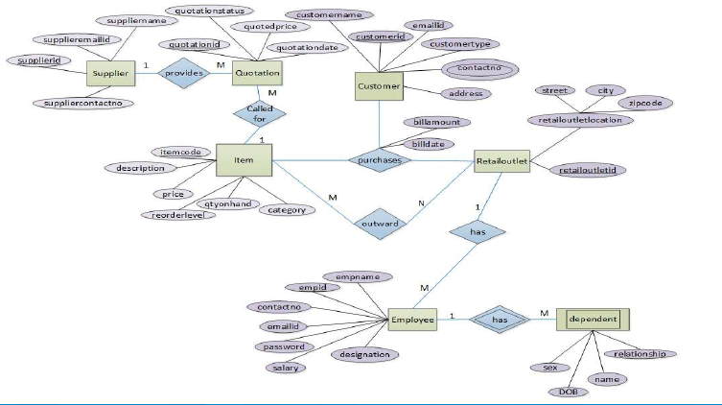
Steps in ER Modeling (5 of 5)

Slide 20
Questions
Construct an E-R diagram for Airline Reservation System.
A university registrar’s office maintains data about the following entities: (a) courses, including number, title, credits, syllabus, and prerequisites; (b) course offerings, including course number, year, semester, section number, instructor(s), timings, and classroom; (c) students, including student-id, name, and program; and (d) instructors, including identification number, name, department, and title. Further, the enrollment of students in courses and grades awarded to students in each course they are enrolled for must be appropriately modeled. Construct an E-R diagram for the registrar’s office. Document all assumptions that you make about the mapping constraints.
Design an E-R diagram for keeping track of the exploits of your favourite sports team. You should store the matches played, the scores in each match, the players in each match and individual player statistics for each match. Summary statistics should be modeled as derived attributes.

Slide 21
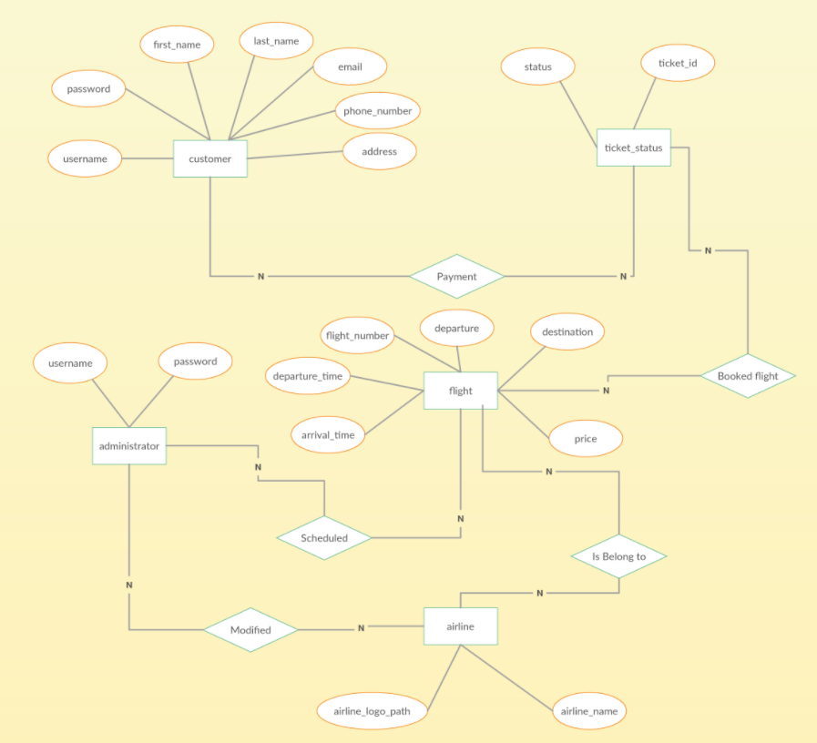
Construct an E-R diagram for Airline Reservation System.

Slide 22
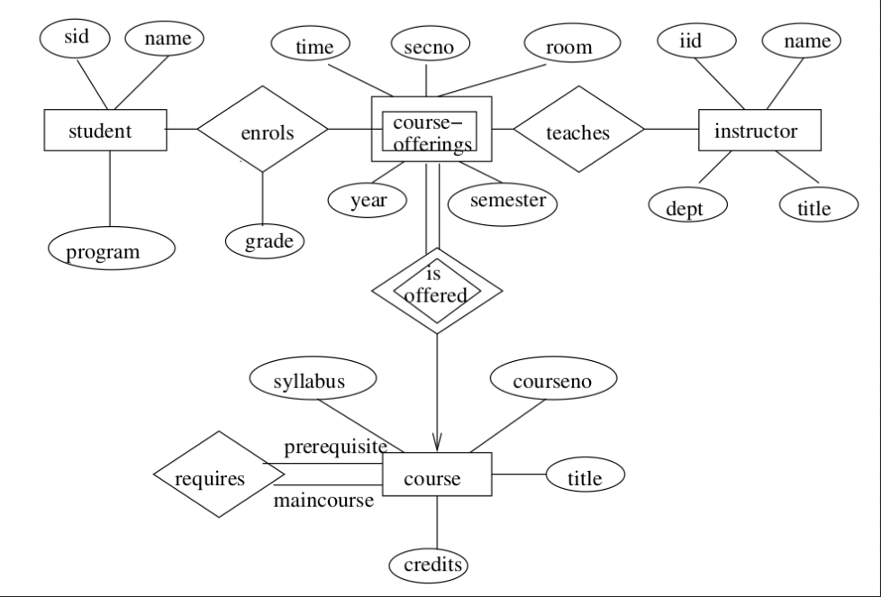
A university registrar’s office maintains data about the following entities: (a) courses, including number, title, credits, syllabus, and prerequisites; (b) course offerings, including course number, year, semester, section number, instructor(s), timings, and classroom; (c) students, including student-id, name, and program; and (d) instructors, including identification number, name, department, and title. Further, the enrollment of students in courses and grades awarded to students in each course they are enrolled for must be appropriately modeled. Construct an E-R diagram for the registrar’s office. Document all assumptions that you make about the mapping constraints.

Slide 23
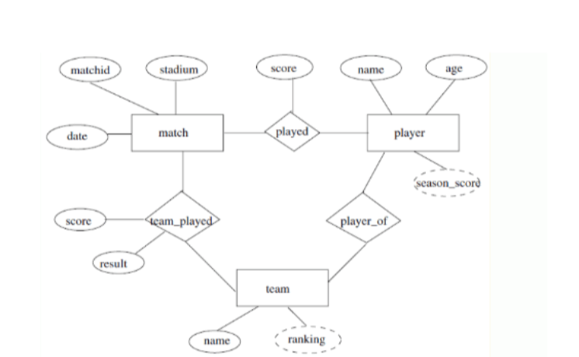
Design an E-R diagram for keeping track of the exploits of your favourite sports team. You should store the matches played, the scores in each match, the players in each match and individual player statistics for each match. Summary statistics should be modeled as derived attributes.

Slide 24
Questions
4. Supreme Products manufactures products like pressure cookers, cookwares, water purifiers, food processors etc. The company markets its products to wholesalers all over the country and dealers sell them to customer. The company has five regional offices and many sales persons are attached to regional offices. Salespersons contact dealers and explain about products, incentives offered, training programs for wholesalers and demo for customers etc. Dealers place orders with the salespersons attached with the regional office of their location. After receiving goods they make payments, which may be in installments. Company would like to develop a system to monitor sales of different products, performance of salespersons and orders from wholesalers.
Do the following :
(i) Identify entities, attribute and relationships giving functionalities and draw E-R diagram for the system.
(ii) Convert this to relational tables explaining logic involved.

Slide 26


